Slide 1
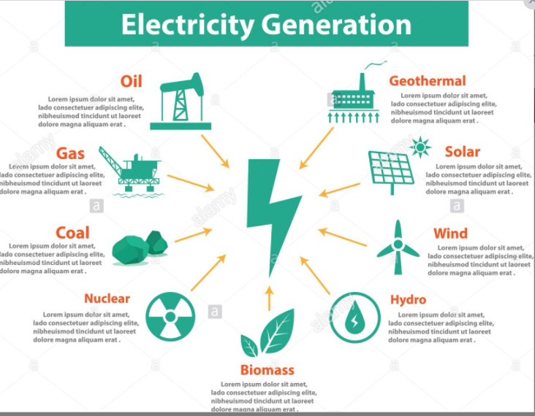
Prediction of Electricity Price and generations
This dataset contains 4 years of electrical consumption, generation, pricing, and data for Spain. Consumption and generation data was retrieved from ENTSOE a public portal for Transmission Service Operator (TSO) data. Settlement prices were obtained from the Spanish TSO Red Electric Espada.
Questions:
Does the current TSO in Spain accurately predict electricity prices?
Prediction of total load for the next hour and finding the difference.

Slide 2
LIBRARIES AND DATASETS
Data Set : https://www.kaggle.com/nicholasjhana/energy-consumption-generation-prices-and-weather
Wrangling Libraries Machine learning
NumPy sklearn
Pandas
Plotting Libraries
Matplotlib
Seaborn
Reporting
Tableau

Slide 3
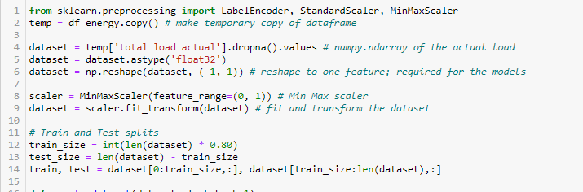
Data Preparation
The energy data set had more null values and data type issue, to fit the data set into any model its important to prepare the data set.
Created test and train data sets and have used MinMaxScaler to scale the data

Slide 4
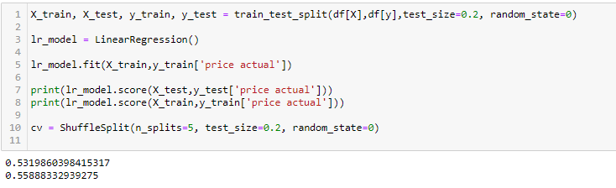
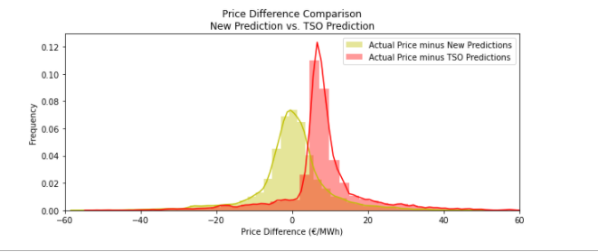
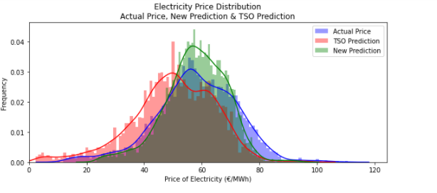
Machine Learning Model
Linear Regression model is used do the predictions on the actual prices and finding the difference between TSO and predicted prices.
We can see that difference in actual and predicted prices are comparatively low to TSO prediction.

Slide 5
Predicted data was exported to csv to do the visualisation in Tableau.
https://public.tableau.com/profile/devika3461#!/vizhome/machinelearning_16135661730130/Story2?publish=yes
END

